Slide 1

TENNIS DATA
ANALYTICS
Manuel
Presentation
Notes:
bonjour

Slide 2


OVERVIEW
01 - Introduction to the business problem and the objectives of the project
02 - Brief description of the dataset and its sources
03 - Statement of the research question and the expected outcomes
Notes:
The goal of this project is to analyze the key factors that contribute to a player's success in tennis matches, using data from the ATP (Association of Tennis Professionals) Men's Tour in 2022, 2023 and 2024.
The dataset contains information on over 2,000 matches played during this period, including details on the players, the surface of the court, the score of the match, and various statistics related to serving and returning.
The analysis will focus on identifying the most important factors that influence a player's chances of winning a match, and on understanding how these factors vary across different contexts (e.g., surface of the court, level of the tournament, etc.).
The results of the analysis will be used to provide insights to tennis players, coaches, and tournament organizers, with the aim of improving performance and optimizing tournament scheduling.
The research question for this project is: "Which factors have the greatest impact on a player's chances of winning a match in tennis, and how do these factors vary across different contexts?" The expected outcomes of the project are a set of insights into the key factors that contribute to match success, and a better understanding of how these factors vary across different contexts. These insights will be presented in the form of data visualizations and statistical analyses, and will be discussed in the context of their practical implications for tennis players, coaches, and tournament organizers.

Slide 3

INTRODUCTION
Which factors have the greatest impact on a player's chances of winning a match?
How do these factors vary depending on the surface of the court, the level of the tournament, and other factors?
Are there any interactions between factors that have a significant impact on match outcomes?
How can players and coaches use this information to improve their performance?

Slide 4
01 DATASET DESCRIPTION
some columns not relevant for analyzing the key factors in match success: 11
focus on columns that provide information about the players' performance during the match, such as their serve statistics

Slide 5

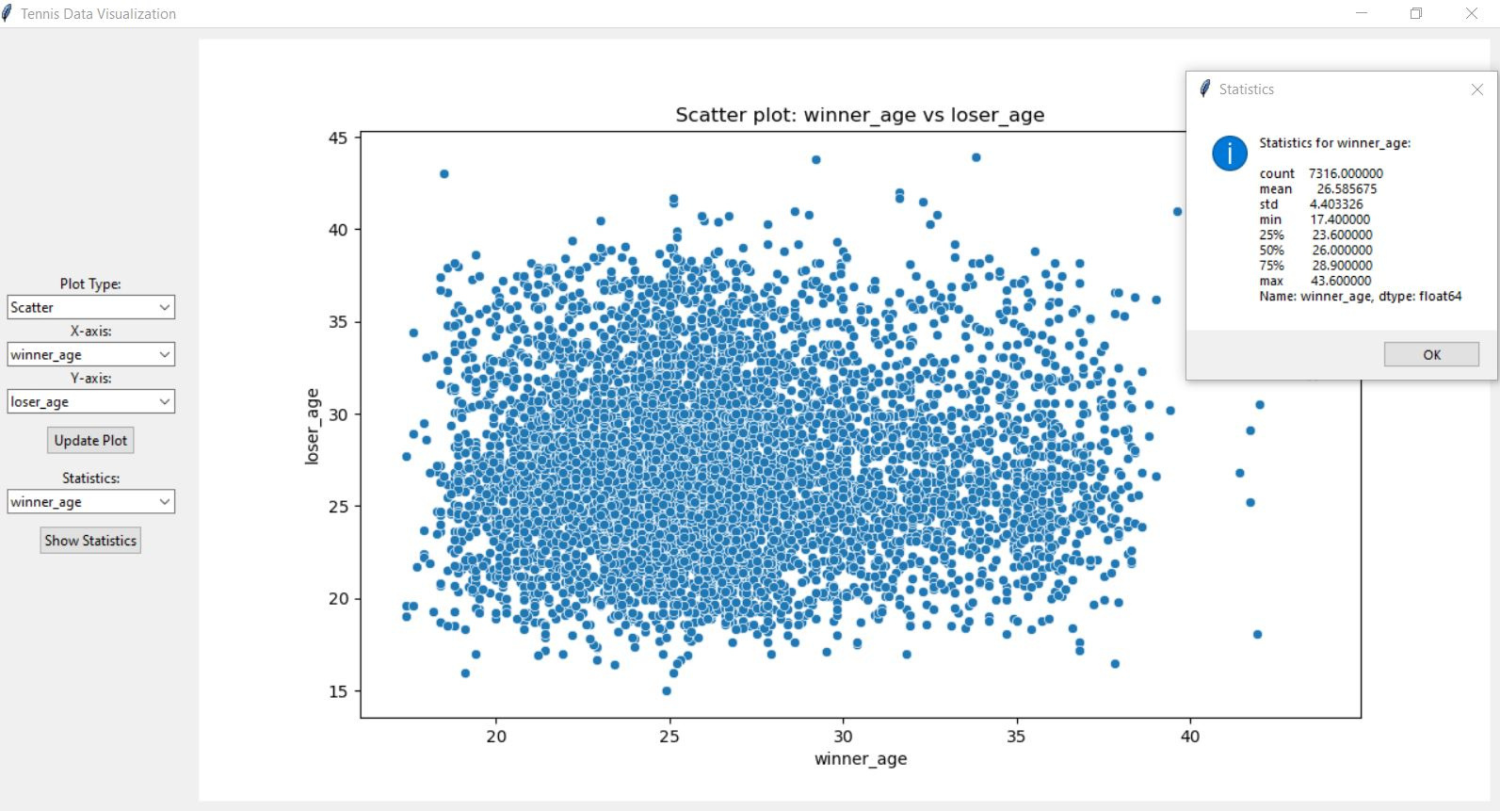
HERE IS A COMPLETE AND FUNCTIONAL PYTHON APPLICATION FOR VIEWING TENNIS DATA FROM THE DATASET PROVIDED
02 E.D.A ?
Notes:
Data cleaning and preprocessing.
Descriptive statistics and visualizations to understand the distribution and relationships between variables.
Identification of any potential issues or areas for further investigation

Slide 6

03 KPI
Selection of relevant KPIs to measure the performance of players and the success of matches
Calculation of KPIs for each player and match in the dataset
Analysis of the relationship between KPIs and match SUCCESS
Notes:
Serve Percentage:
Winner Serve Percentage (w_serve_pct): The percentage of first serves won by the winner.
Loser Serve Percentage (l_serve_pct): The percentage of first serves won by the loser.
Serve Percentage Difference (serve_pct_diff): The difference in serve percentage between the winner and the loser.
Return Percentage:
Winner Return Percentage (w_return_pct): The percentage of return points won by the winner.
Loser Return Percentage (l_return_pct): The percentage of return points won by the loser.
Return Percentage Difference (return_pct_diff): The difference in return percentage between the winner and the loser.
Aces and Double Faults:
Winner Aces (w_ace): The number of aces served by the winner.
Loser Aces (l_ace): The number of aces served by the loser.
Winner Double Faults (w_df): The number of double faults committed by the winner.
Loser Double Faults (l_df): The number of double faults committed by the loser.
Ranking:
Winner Rank (winner_rank): The ranking of the winner at the time of the match.
Loser Rank (loser_rank): The ranking of the loser at the time of the match.
Rank Difference (rank_diff): The difference in ranking between the winner and the loser.

Slide 7

# Calculate difference in serve percentage and return percentage between winner and loser :
df['serve_pct_diff'] = df['w_serve_pct'] - df['l_serve_pct']
df['return_pct_diff'] = df['w_return_pct'] - df['l_return_pct']
03- KPI CALCULATION

Slide 8
04 HYPOTHESIS TESTING
FORMULATION OF HYPOTHESES BASED ON THE EDA AND KPI ANALYSIS
SELECTION OF APPROPRIATE STATISTICAL TESTS TO TEST THE HYPOTHESES
INTERPRETATION OF THE RESULTS AND EVALUATION OF THE EVIDENCE IN SUPPORT OF THE HYPOTHESES

Slide 9


04 -HYPOTHESIS TESTING
RACKET
sportswear
tennis ball
wristbands
clue
Hypothesis 1: Higher-ranked players have a higher serve percentage.
Null Hypothesis (H0): There is no difference in serve percentage between higher-ranked and lower-ranked players.
Alternative Hypothesis (H1): Higher-ranked players have a higher serve percentage than lower-ranked players.
unt ut labore et dolore magna aliqua. Ut enim ad minim veniam, quis nostrud exercitation ullamco laboris nisi ut aliquip ex ea commodo consequat.

Slide 10
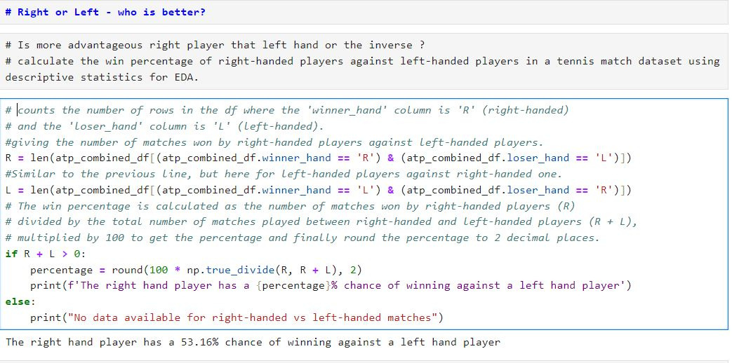
04 HYPOTHESIS TESTING

Slide 11
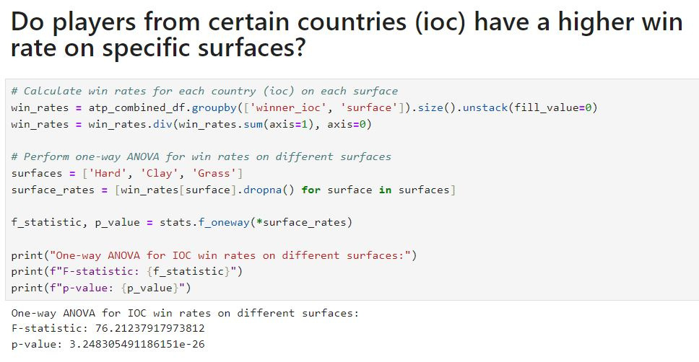
04 HYPOTHESIS TESTING

Slide 12
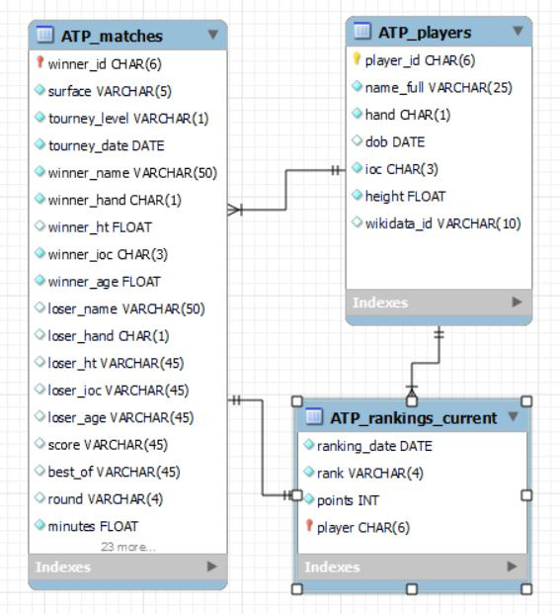
5 SQL PART
YOUR PA

Slide 13
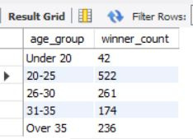
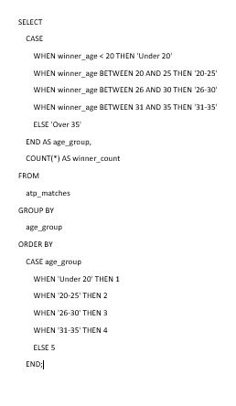
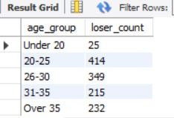
5 SQL PART

Slide 14
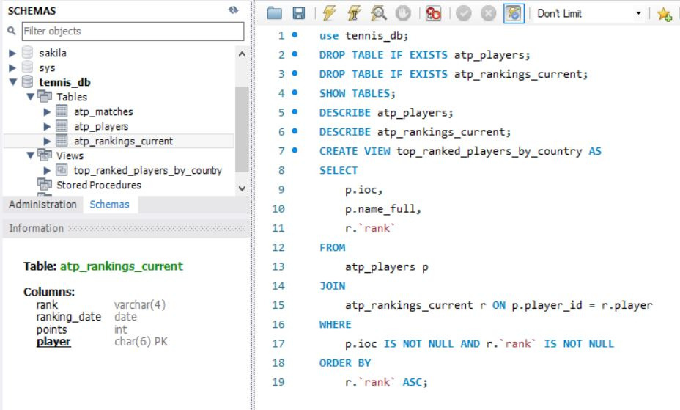
5 SQL PART
Creating a view for top_ranked_players_by_country

Slide 15
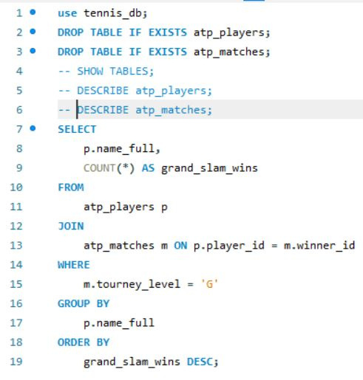
5 SQL PART

Slide 16
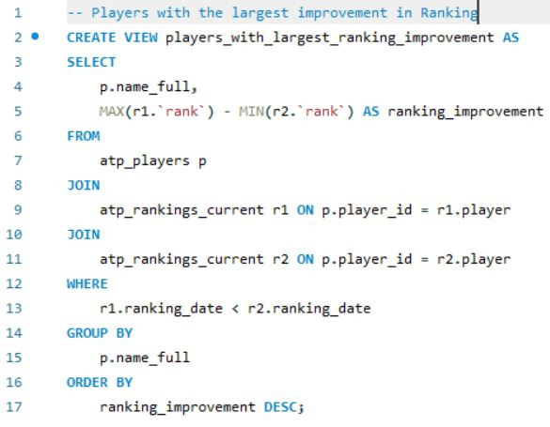
5 SQL PART

Slide 17
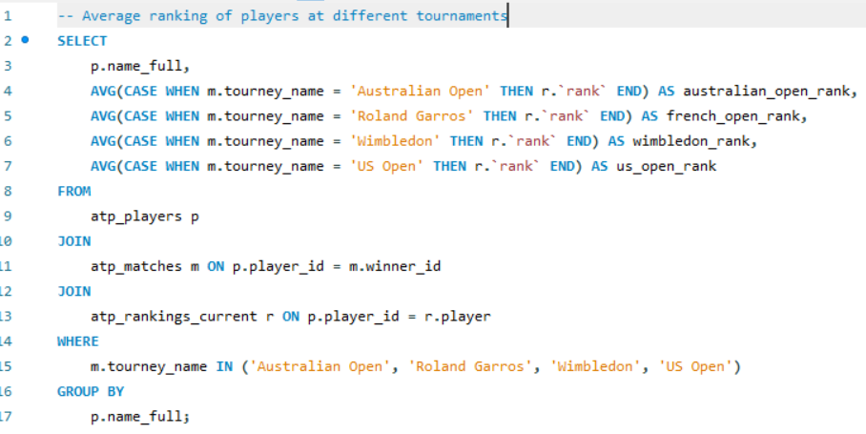
5 SQL PART

Slide 18
CREATE AN API USING A WEB FRAMEWORK : FLASK IN PYTHON
YOUR PA
3 API ENDPOINTS CREATION
API USE
/TOP_PLAYERS: RETURNS THE TOP 10 PLAYERS
BASED ON THE NUMBER OF MATCHES WON.
INSTALL PANDAS & FLASK LIBRARIES
/SURFACE_STATS: PROVIDES AVERAGE
STATISTICS
FOR EACH PLAYING SURFACE
SAVE THE SCRIPT AS TENNIS_API.PY IN THE SAME DIRECTORY AS YOUR CSV AND RUN IT.
/PLAYER_STATS/<PLAYER_NAME>: GIVES
DETAILED
STATS FOR A SPECIFIC PLAYER.
THE API WILL BE ACCESSIBLE AT HTTP://LOCALHOST:5000.

Slide 19
CREATE AN API USING A WEB FRAMEWORK : FLASK IN PYTHON
YOUR PA
3 API ENDPOINTS TEST
TOP PLAYERS: HTTP://LOCALHOST:5000/TOP_PLAYERS
SURFACE STATS: HTTP://LOCALHOST:5000/SURFACE_STATS
PLAYER STATS: HTTP://LOCALHOST:5000/
PLAYER_STATS/FELIX AUGER ALIASSIME

Slide 20
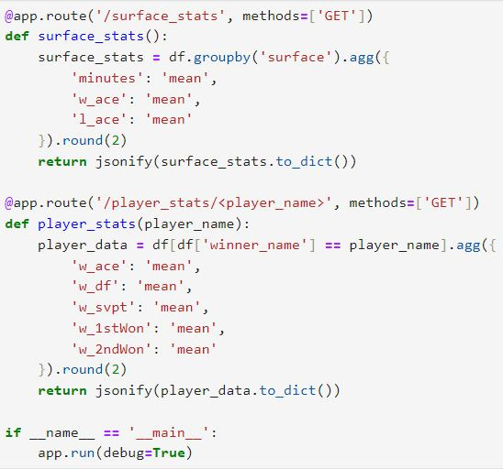
CREATE AN API USING A WEB FRAMEWORK : FLASK IN PYTHON
YOUR PA

Slide 21
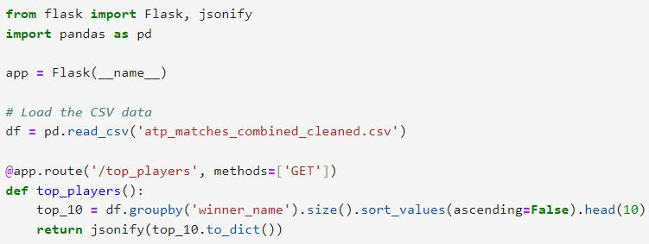
CREATE AN API USING A WEB FRAMEWORK : FLASK IN PYTHON
YOUR PA

Slide 22
THANK YOU FOR LISTENING
YOUR PA
MANUEL

Slide 23
THANK YOU FOR LISTENING
YOUR PA
MANUEL

